Slide 1
CASA DI CURA SAN CAMILLO
FORTE DEI MARMI (LU)
CHIRURGIA ARTROSCOPICA E PROTESICA
Alessandro Tripodo
alessandro.tripodo@camilliani.net

Slide 2
PLANNING PREOPERATORIO E SCELTA DEL GRADO DI VINCOLO DELL’IMPIANTO PROTESICO

Slide 3
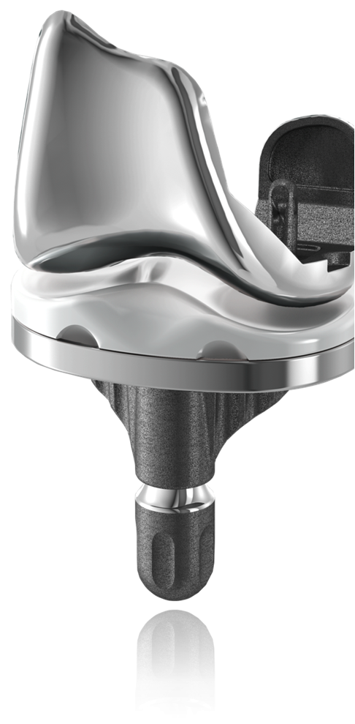
L’impianto protesico ideale:
Facile applicabilità e in tempi brevi
Facilmente sostituibile in caso di revisione
Ampie indicazioni
Longevità
Bassa incidenza di complicazioni

Slide 4
L’impianto protesico ideale:
Massimo grado di soddisfazione del paziente anziano e non

Slide 5
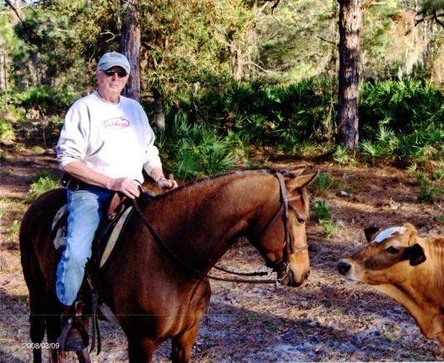
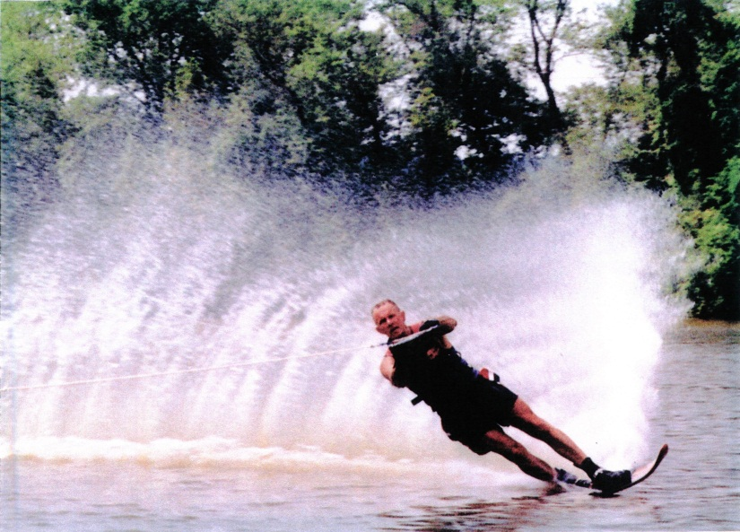
OBIETTIVO PRINCIPALE:
Ridurre il dolore
Ripristinare la funzione
Dare stabilità
Durare a lungo

Slide 6
Chiave della durata nel tempo:
Ripristinare l’asse meccanico
Ottimizzare il bilanciamento
in flessione ed in estensione
Ripristinare la cinematica
Ottenere ottimale fissazione

Slide 7
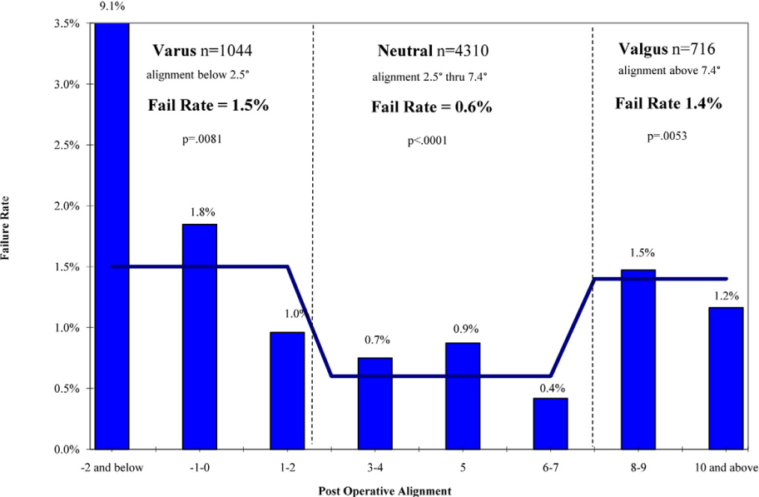
Coronal Alignment and Failure Rate
Ripristinare l’asse meccanico
Lower failure rate when mechanical alignment is restored
The more we fail to restore neutral alignment, the higher revision rate is expected.
Ritter, et al: JBJS 93(A) 17, 2011
Notes:
- At what degrees and in which circumstances do knees fail?
- Well, they fail exactly in the zones that navigation or a form of guidance help us avoid
If you look at a recent study from Ritter et al., knees have lower failure rate at 6-7 degrees of anatomical axis ( or 0⁰ mechanical) and final HKA alignment with varus greater than 2 degrees anatomical (7-8 ⁰ varus mechanical) have a failure rate of 9.1%. This rate is multiplied in the obese patients population.
Addionally, this study is telling us that:
- Compensating for valgus femoral malalignment with a more varus tibial component (≥8° valgus) to achieve neutral overall alignment is associated with a 7.8% failure rate
- Compensating with one of the 2 component to reach overall alignment was associate with higher failure rate
- Again if we show in this graphic some guidance technology data, we see that navigation can help us out in the areas where failure rate is at its highest.
- Cut validation is key
Other details of the study (if you want to use them)
On 6070 TKA, mean duration for follow-up 7.6 years (+/-3.8y), 6 surgeons performed surgeries
Knees with both neutral tibial and femoral alignment has the lowest failure rate 0.2% (9/4633)
60.5% of knees (3673/6070) were well-aligned in the three measures (tibial alignment, femoral alignment and overall anatomic alignment) and were associated with a 0.22% failure rate
39.5% of knees (2397/6070) in which at least one of the three measures was not neutral had a failure rate of 1.9% (46/2397)

Slide 8
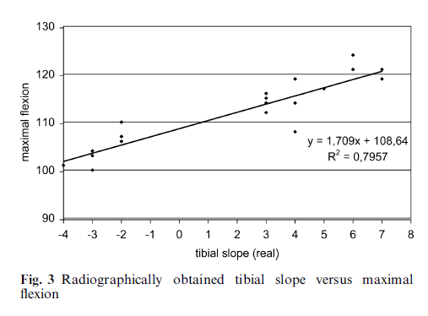
Sagittal Alignment and Function
Ripristinare l’asse meccanico
target slope 4°
target slope 7°
target slope 0°
Importance of restoring the correct tibial slope to achieve good flexion!
Bellemans et al., 2005
Notes:
- At what degrees and in which circumstances do knees fail?
- Well, they fail exactly in the zones that navigation or a form of guidance help us avoid
If you look at a recent study from Ritter et al., knees have lower failure rate at 6-7 degrees of anatomical axis ( or 0⁰ mechanical) and final HKA alignment with varus greater than 2 degrees anatomical (7-8 ⁰ varus mechanical) have a failure rate of 9.1%. This rate is multiplied in the obese patients population.
Addionally, this study is telling us that:
- Compensating for valgus femoral malalignment with a more varus tibial component (≥8° valgus) to achieve neutral overall alignment is associated with a 7.8% failure rate
- Compensating with one of the 2 component to reach overall alignment was associate with higher failure rate
- Again if we show in this graphic some guidance technology data, we see that navigation can help us out in the areas where failure rate is at its highest.
- Cut validation is key
Other details of the study (if you want to use them)
On 6070 TKA, mean duration for follow-up 7.6 years (+/-3.8y), 6 surgeons performed surgeries
Knees with both neutral tibial and femoral alignment has the lowest failure rate 0.2% (9/4633)
60.5% of knees (3673/6070) were well-aligned in the three measures (tibial alignment, femoral alignment and overall anatomic alignment) and were associated with a 0.22% failure rate
39.5% of knees (2397/6070) in which at least one of the three measures was not neutral had a failure rate of 1.9% (46/2397)

Slide 9
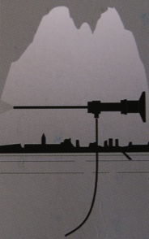
LA PTG NON E’ DA CONSIDERARE UN INTERVENTO SEMPLICE

Slide 10
PLANNING PREOPERATORIO PROTESI TOTALE ANCA
Primi impianti e revisioni
- taglia
- offset
- lunghezza

Slide 11
PLANNING PREOPERATORIO PROTESI TOTALE GINOCCHIO
Poco utilizzato
Taglia mono e totale
Allineamento
Casi difficili post-traumatici e revisioni??

Slide 12
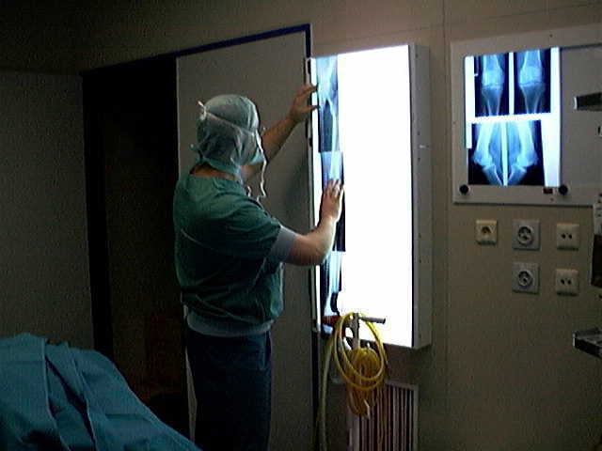
TC PREOP
STUDIO DEFORMITA’, DEFICIT OSSEI O ALTRO……

Slide 13
Uomo 83aa

Slide 14
Uomo 73aa

Slide 15
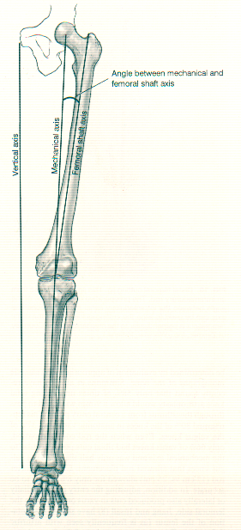
RX preop
Standing AP hip-knee-ankle
Standing AP knee
Supine lateral knee
Sunrise view patella

Slide 16
Templating Method Femoral Size
Lateral radiograph
Undersized Correct

Slide 17
Templating Method Tibial Size
Lateral radiograph
At fibular head

Slide 18
Templating Method Alignment
Hip – knee – ankle radiograph
Distal femur resection angle
goal 0° hip-knee

Slide 19
Templating Method Alignment
Standing AP knee radiograph
Prox. tibial resection (goal 0°)
measure med, lat resection (mm)

Slide 20
L’ENTRY POINT è INDIVIDUALE come lo è il paziente.
L’ ENTRY POINT per la guida intramidollare è il punto dove l’asse anatomico interseca la superficie distale femorale articolare.

Slide 21
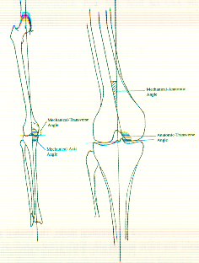
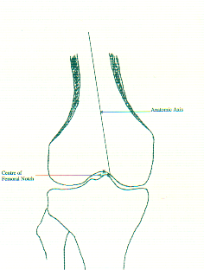
The entry point :

Slide 22
Si raccomanda:
L‘identificazione dell’asse anatomico e conseguentemente l’entry point.

Slide 23
Templating Primary TKA Conclusioni
Planning Pre-op per scegliere taglia
Per l’allineamento sul piano coronale
Per corretto entry point
Planning è semplice, no spese aggiuntive ed applicabile a qualunque tipologia di impianto

Slide 24
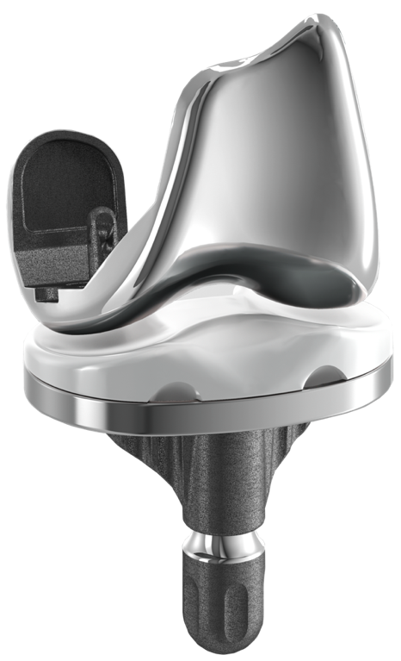
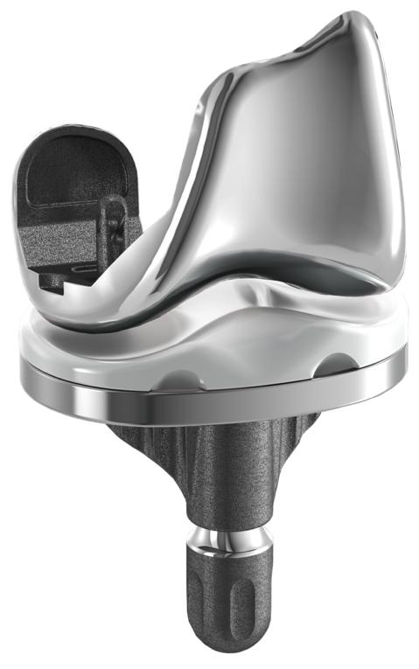
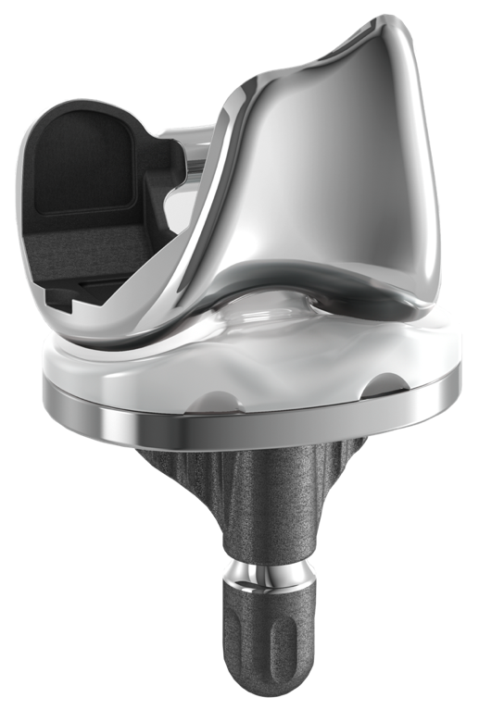
Quale tipo di protesi scegliere??
Una protesi per ogni ginocchio
KR
Kinematic Retaining
CR
Cruciate Retaining
PS
Posterior Stabilized

Slide 25
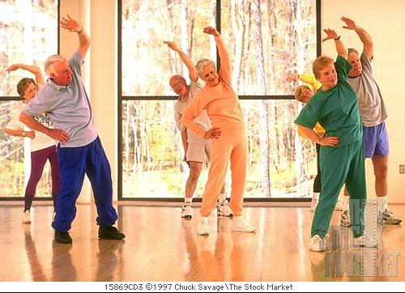
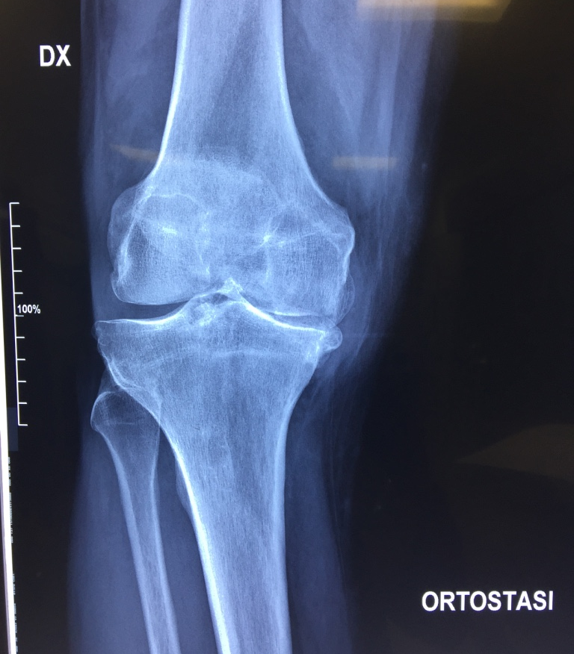
CLASSIFICARE IL PAZIENTE
Età anagrafica e biologica
Livello di attività
Tipo di lesione/patologia

Slide 26
SCELTA DEL TIPO DI PROTESI
PREFERIAMO USARE L’IMPIANTO MENO VINCOLATO PER QUEL TIPO DI PAZIENTE E DI GINOCCHIO
CR: QUANDO NON VI E’ ALTERAZIONE IMPORTANTE DELLA ANATOMIA O INSTABILITA’ DEL LCP
PS: OTTIMA SCELTA QUANDO COLLATERALI SUFFICIENTI E PCL NO
SEMIVINCOLATA: QUANDO PRESENTE MODERATA INSTABILITA’ IN VARO-VALGO
VINCOLATA: GRAVE INSTABILITA’
26

Slide 27
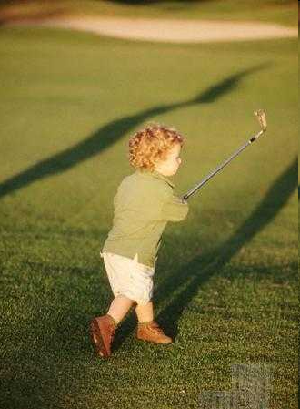
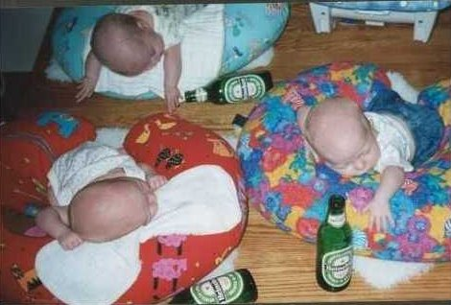
Età anagrafica/biologica

Slide 28
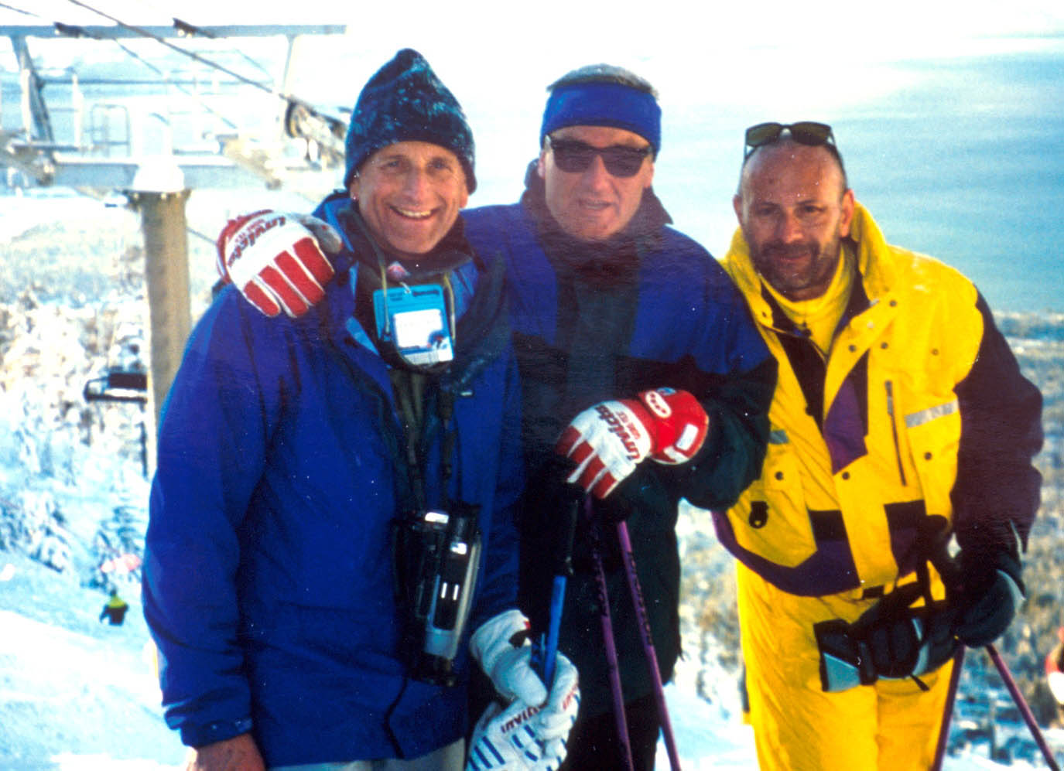
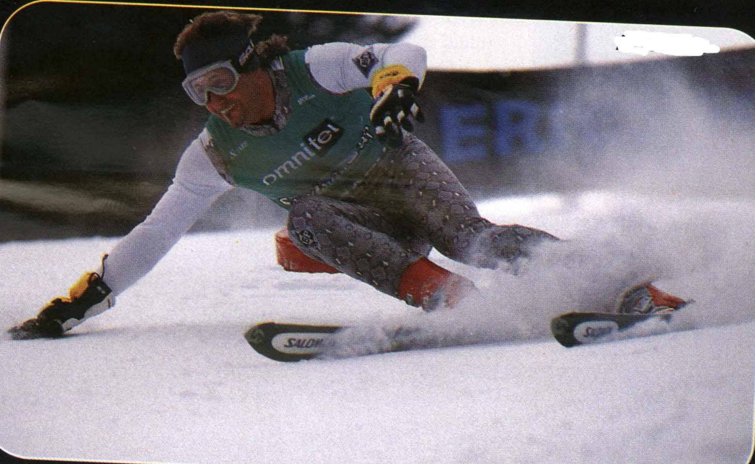
Livello di attività

Slide 29
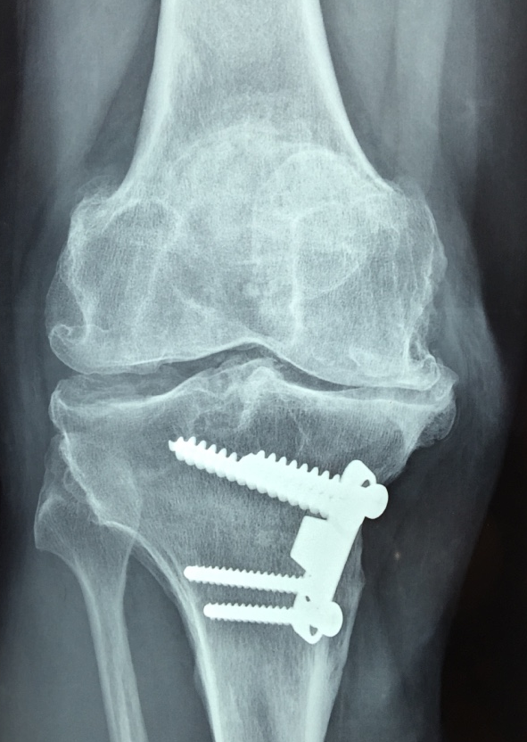
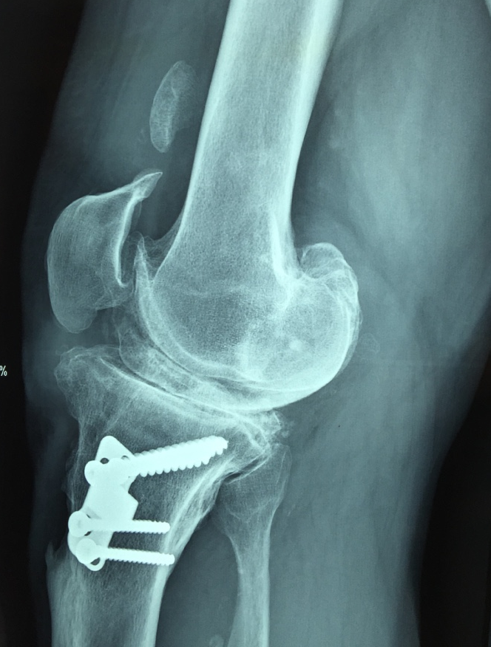
Tipo di lesione/patologia

Slide 30
QUANDO CR
OTTIMA QUALITA’ OSSEA
LCP FUNZIONALMENTE VALIDO
COLLATERALI OTTIMALI
PZ ATTIVO

Slide 31
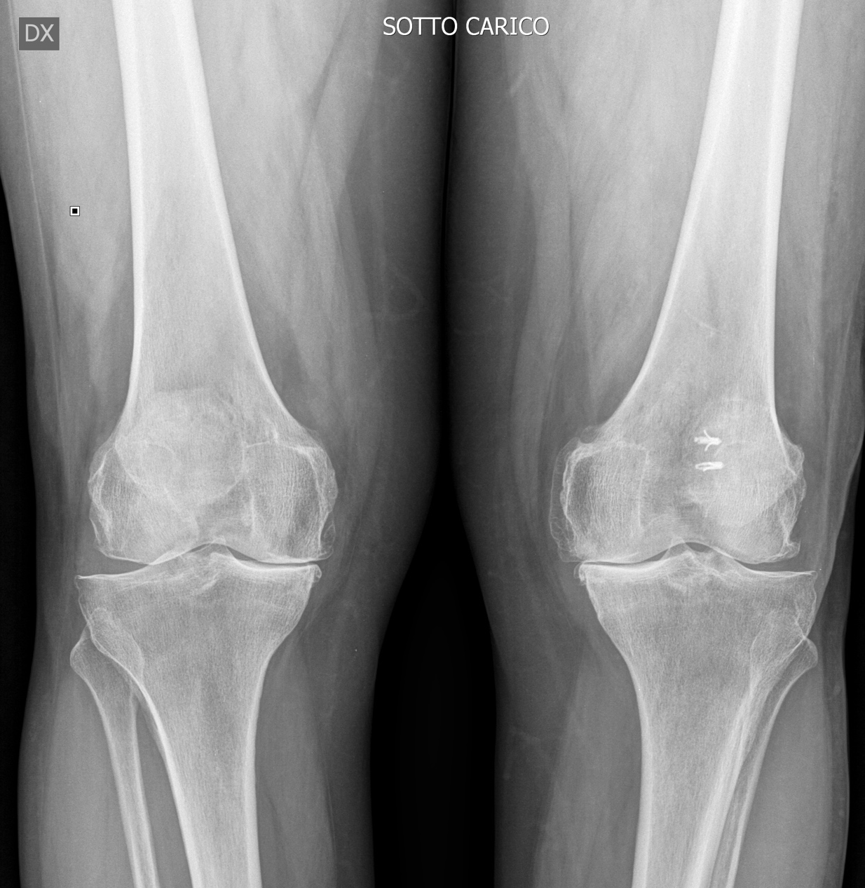
Donna 68aa

Slide 32
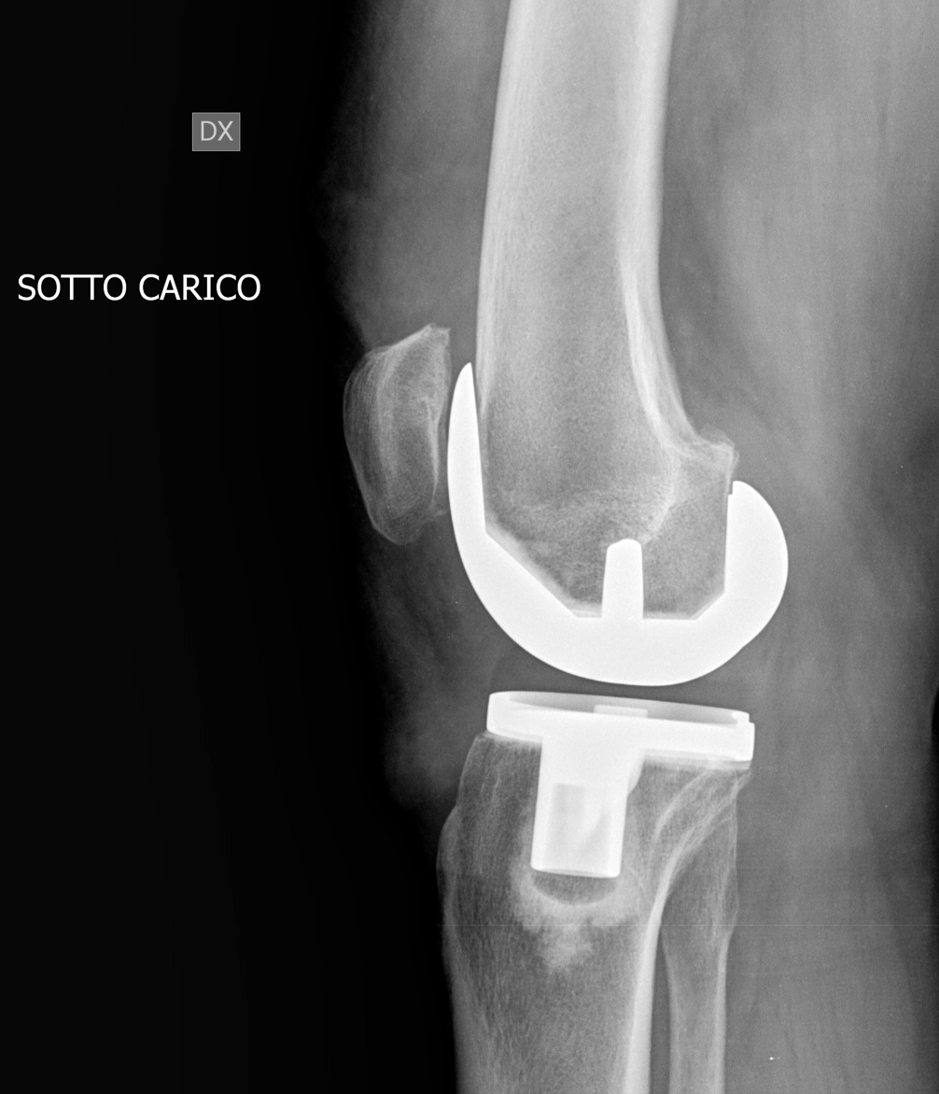
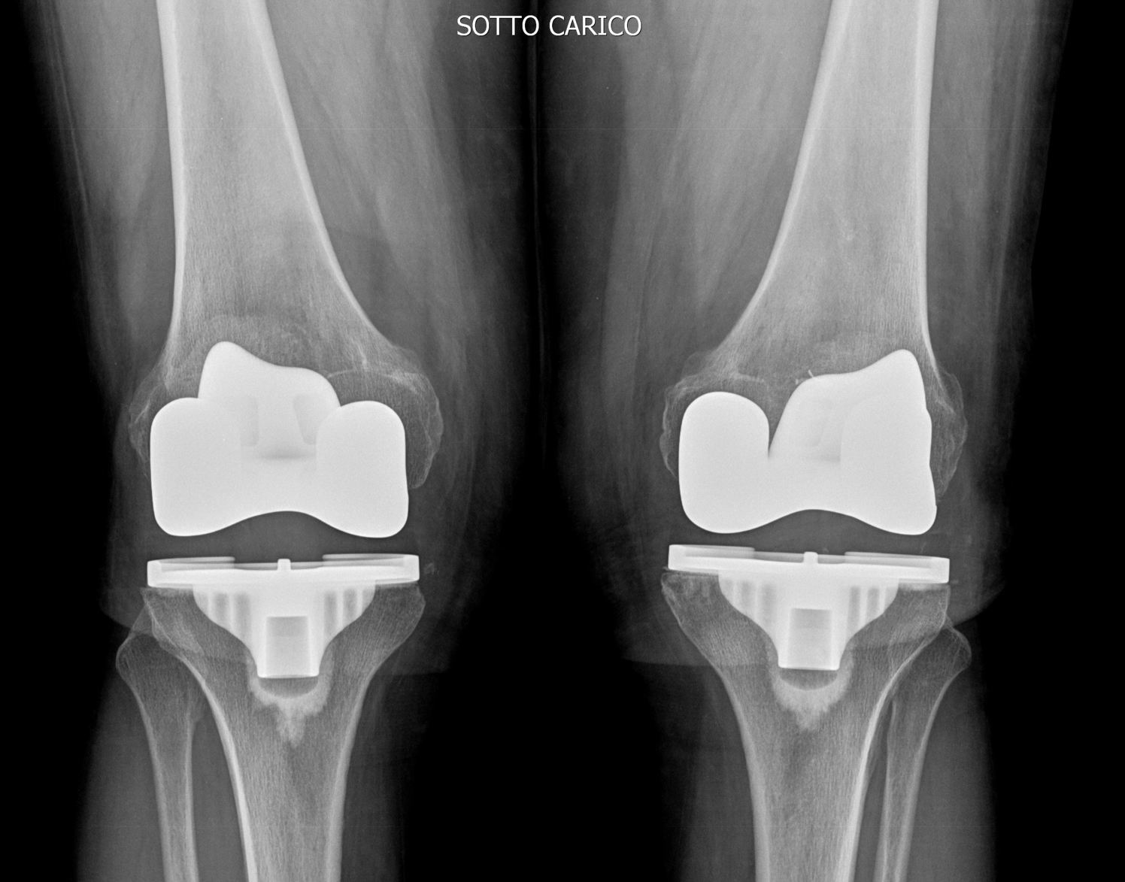
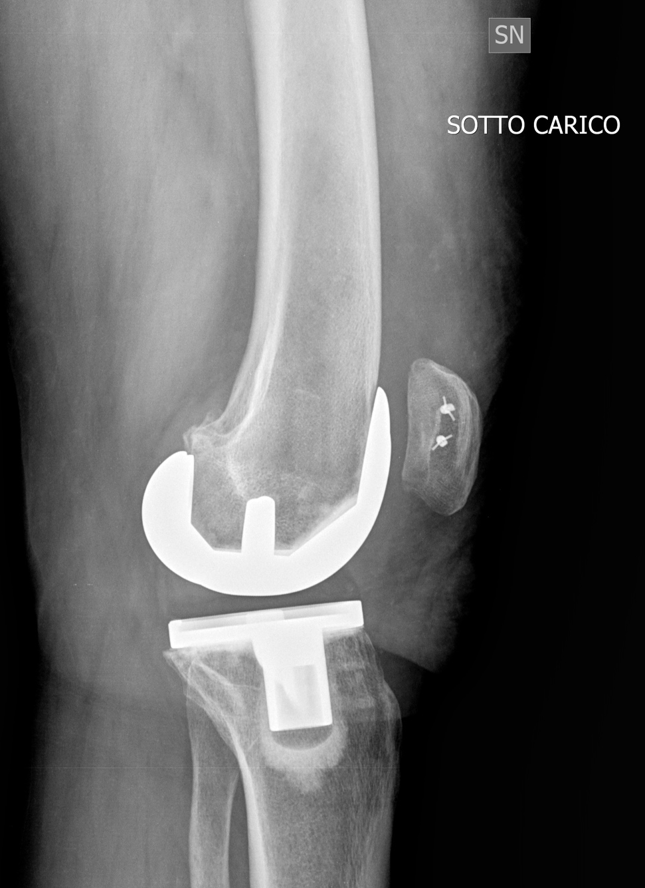
Donna 68aa

Slide 33
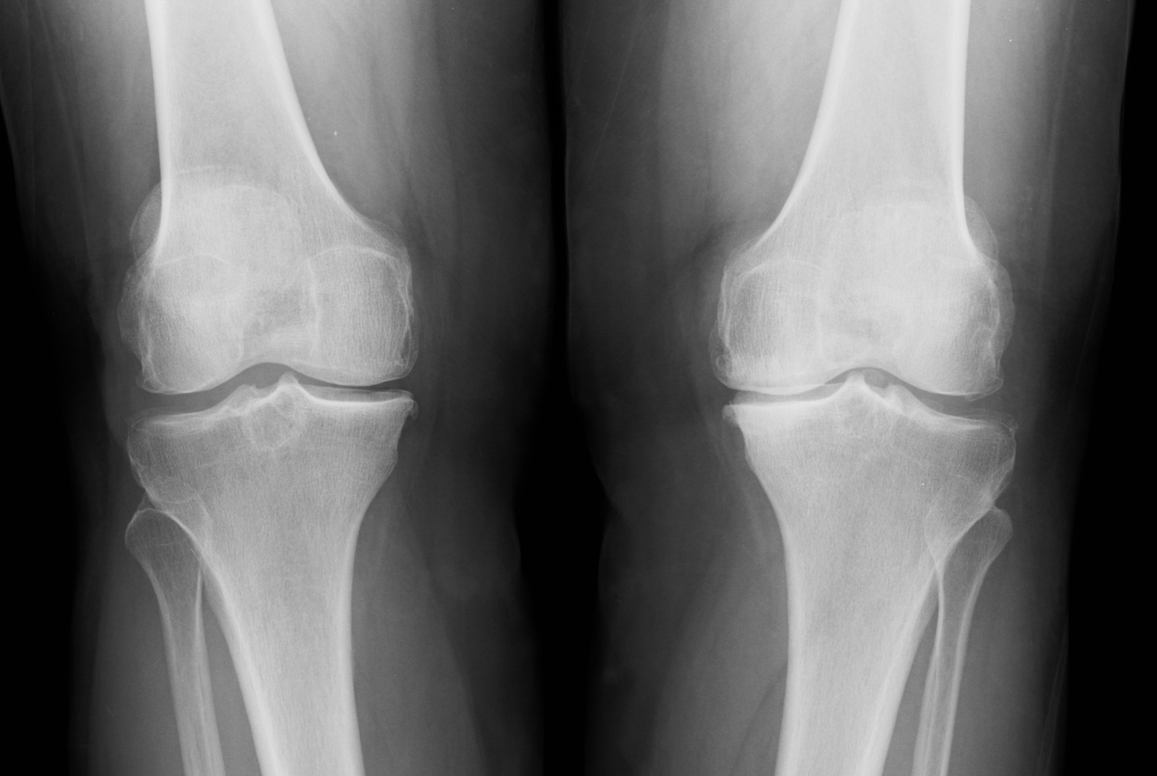
Donna 75aa

Slide 34
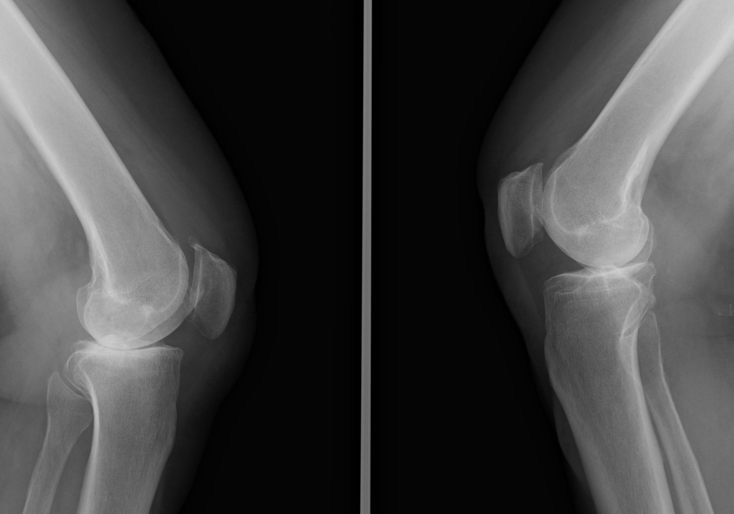
Donna 75aa

Slide 35
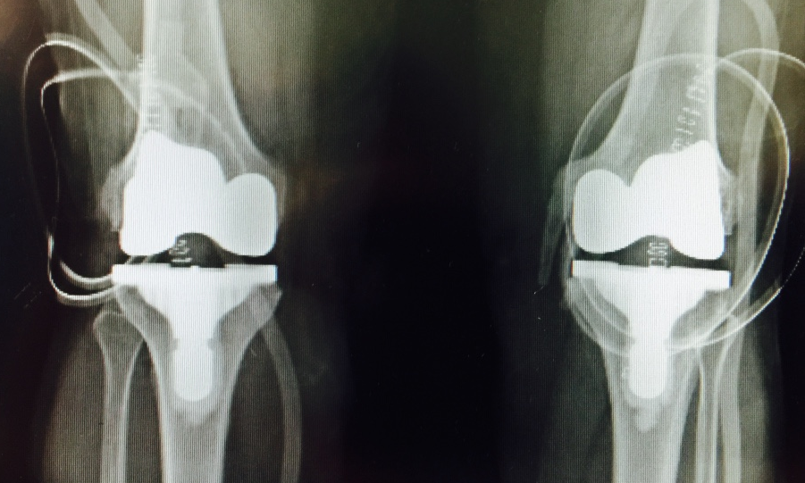
Donna 75aa

Slide 36
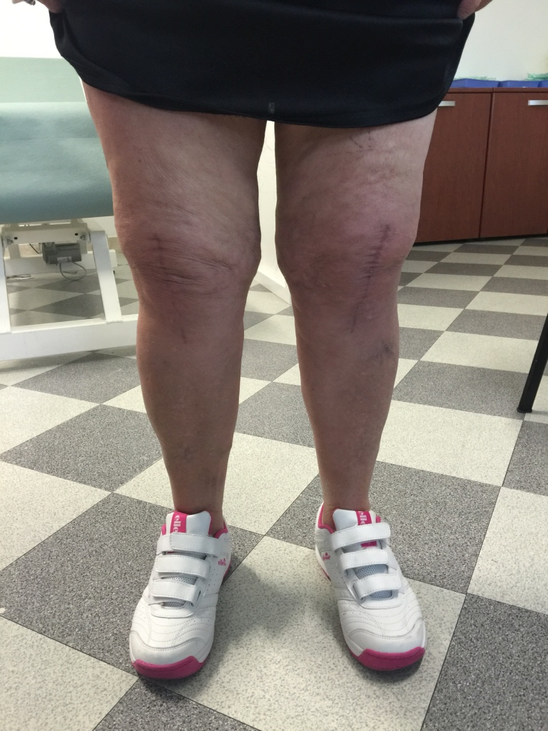
Donna 75aa

Slide 37
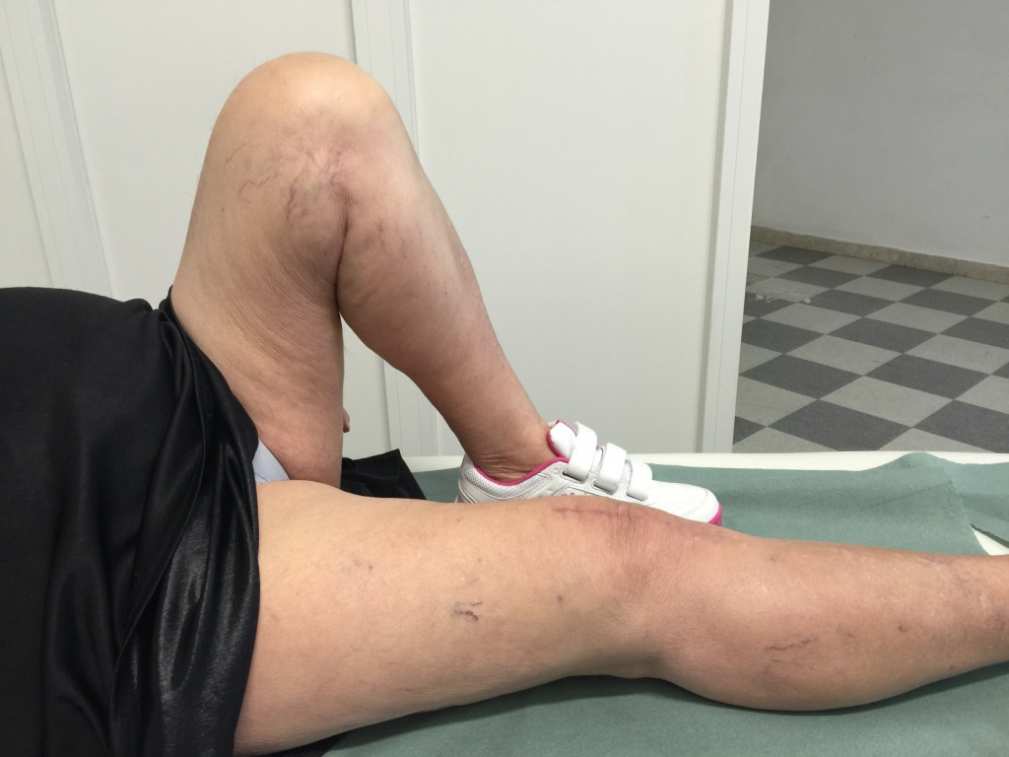
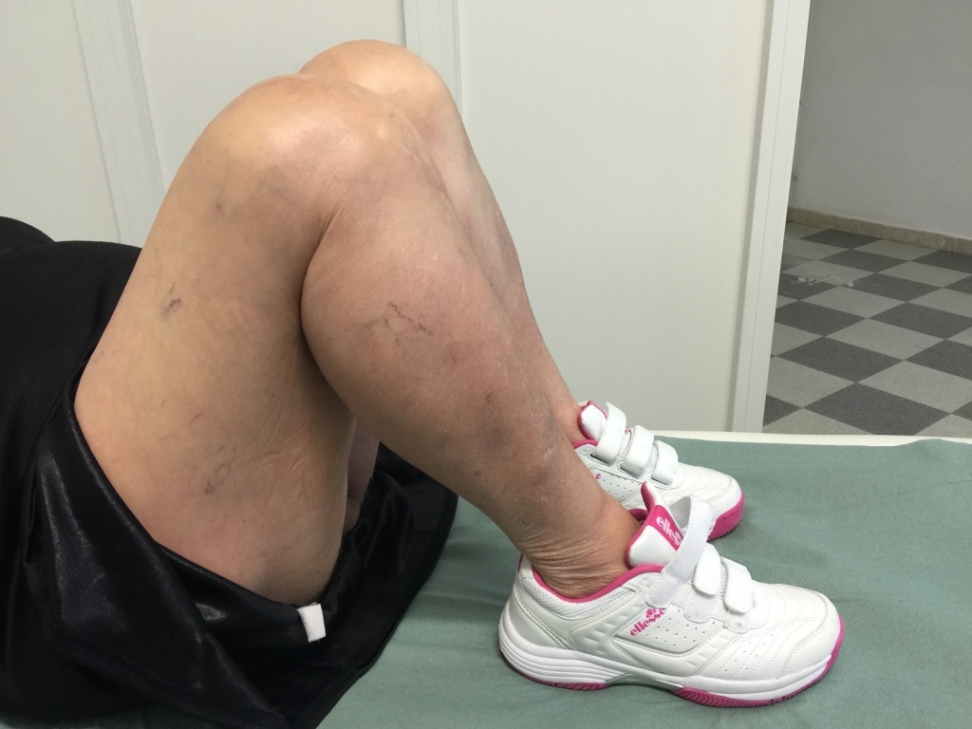
Donna 75aa

Slide 38
QUANDO PS
BUONA QUALITA’ OSSEA
PIVOT CENTRALE INSTABILE
COLLATERALI SUFFICIENTI

Slide 39
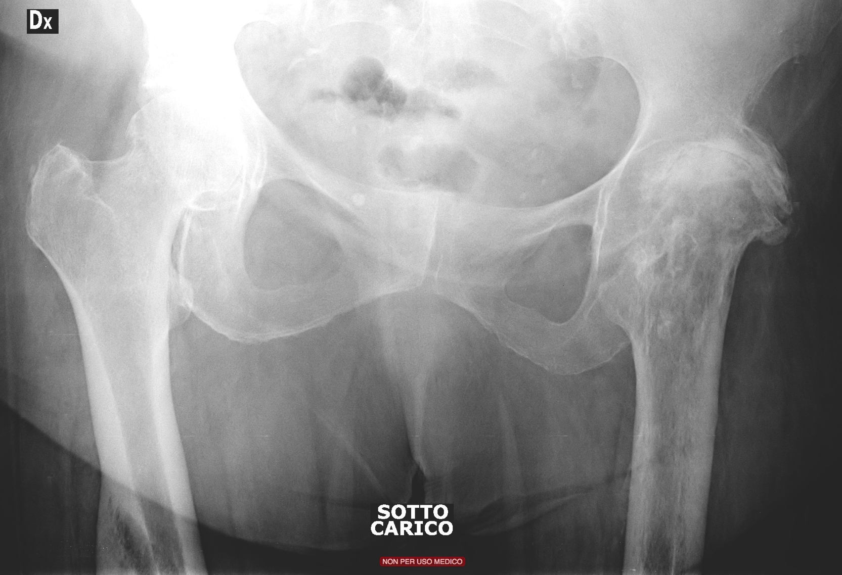
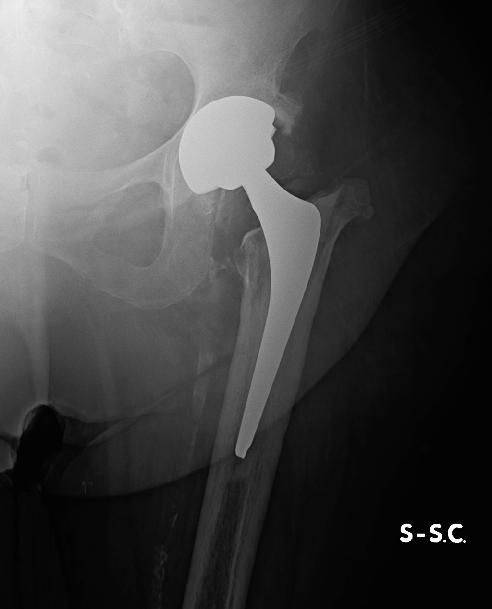
Donna 67aa

Slide 40
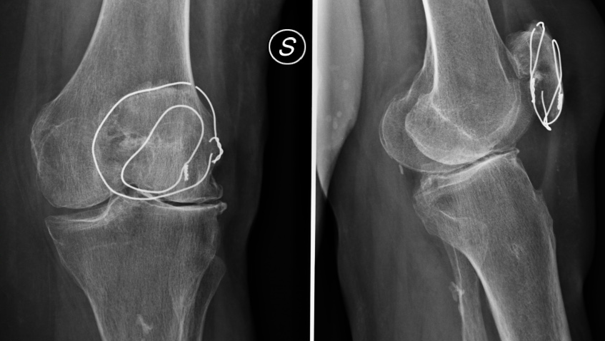
Donna 67aa

Slide 41
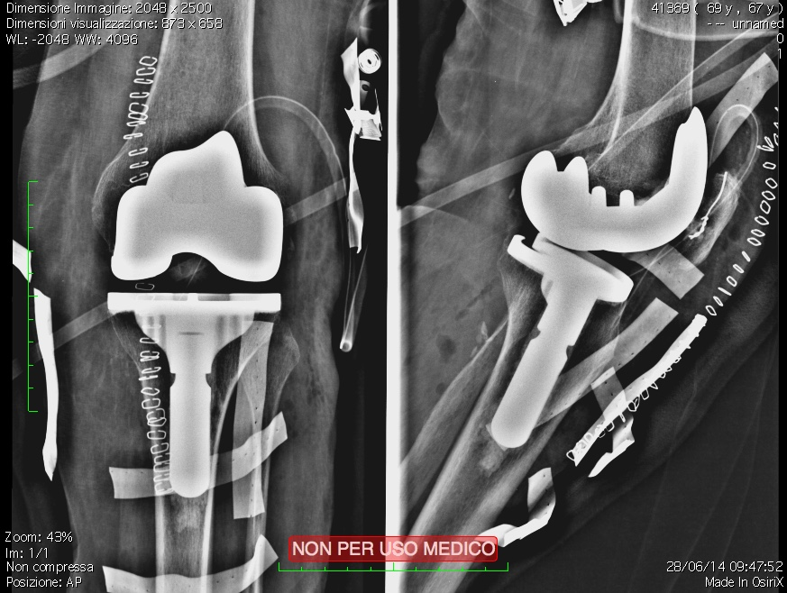
Donna 67aa

Slide 42
Uomo 56aa

Slide 43
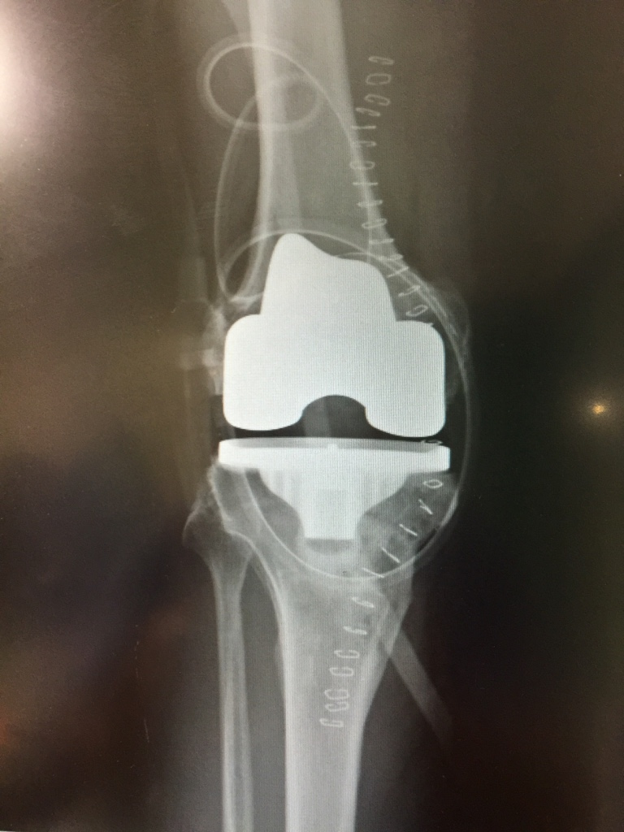
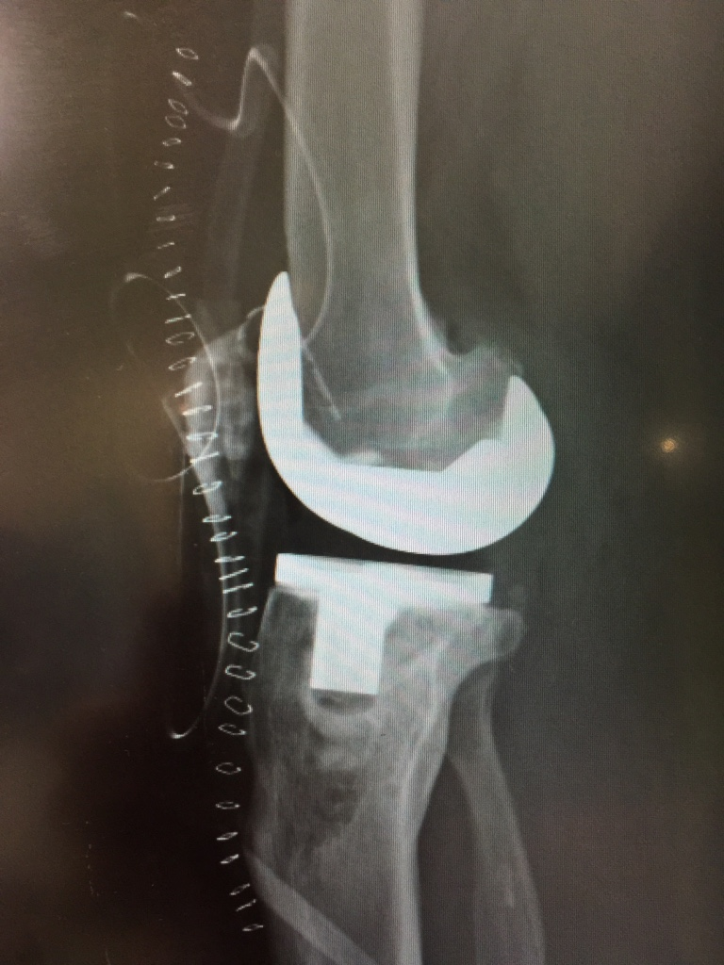
Uomo 56aa

Slide 44
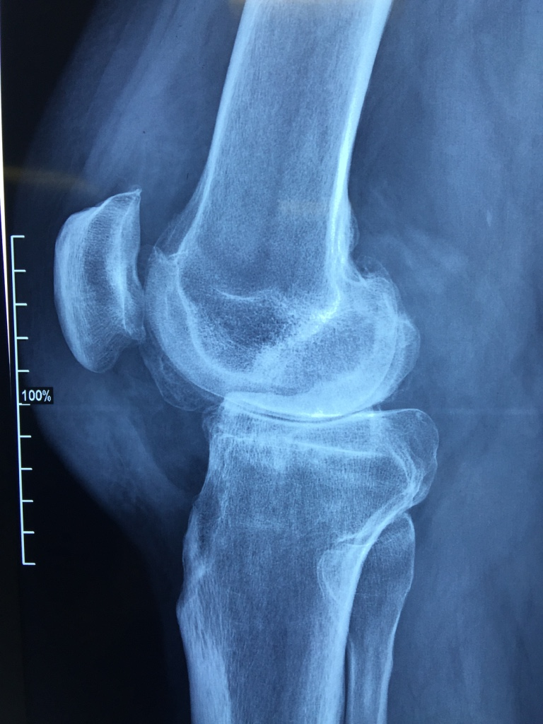
Uomo 45aa

Slide 45
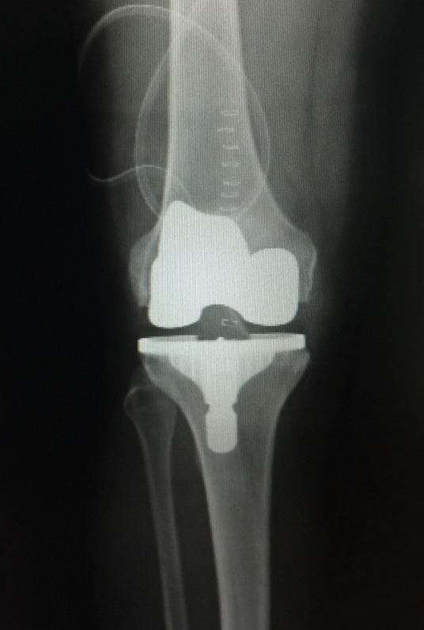
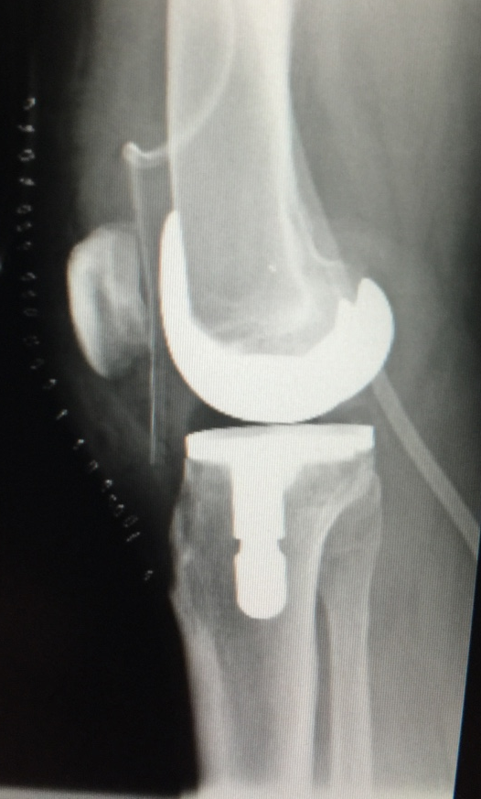
Uomo 45aa

Slide 46
QUANDO SEMIVINCOLATE
DISCRETA QUALITA’ OSSEA
PIVOT CENTRALE INSTABILE
COLLATERALI MODERATAMENTE INSUFFICIENTI

Slide 47
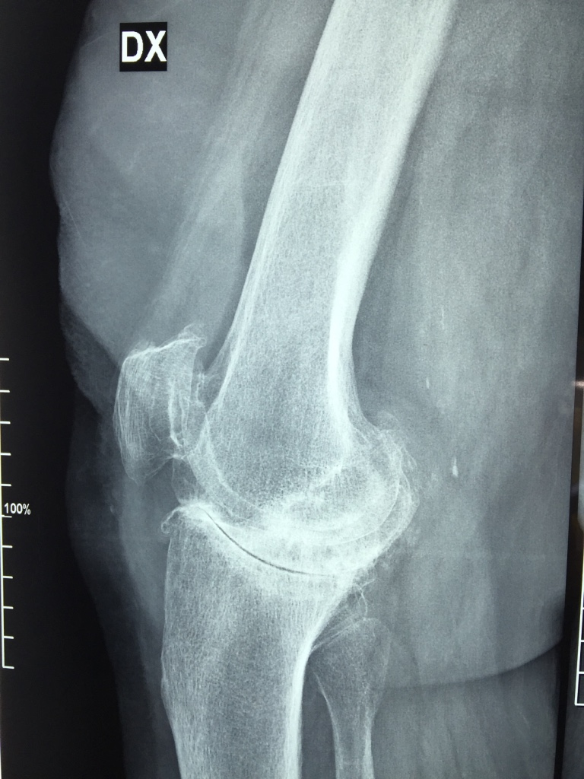
DONNA 76aa

Slide 48
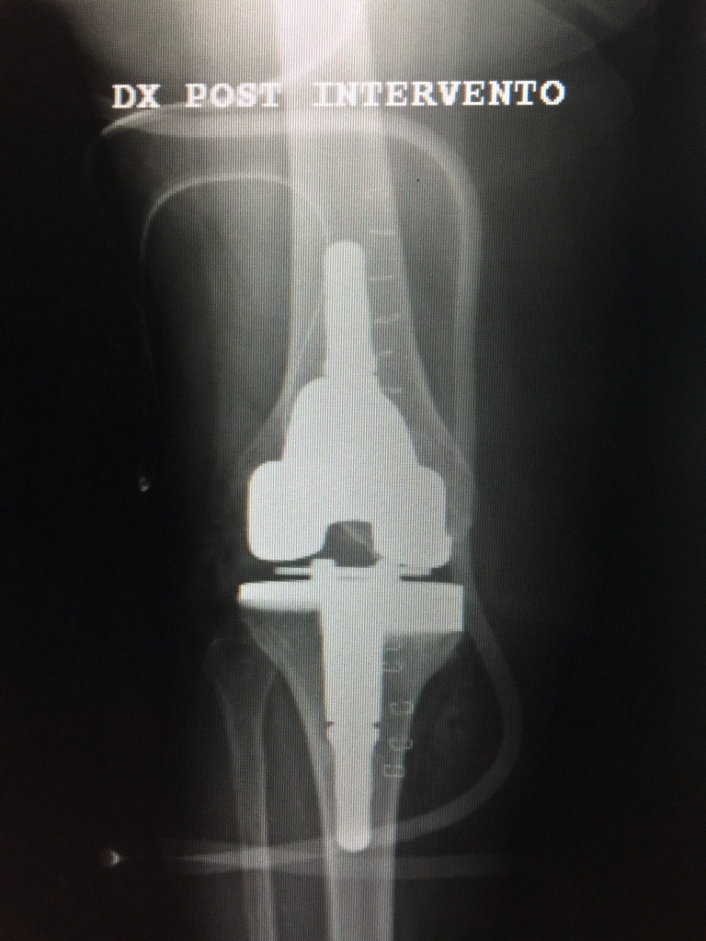
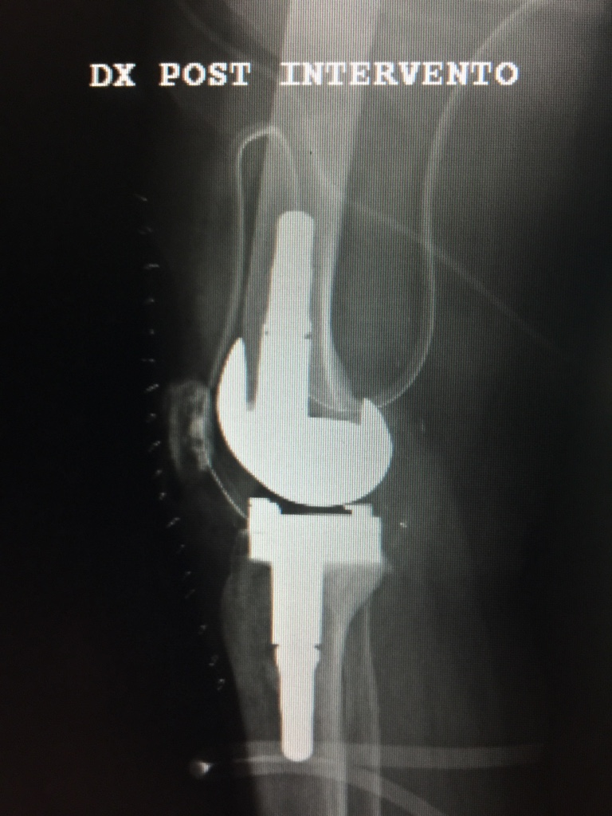
DONNA 76aa

Slide 49
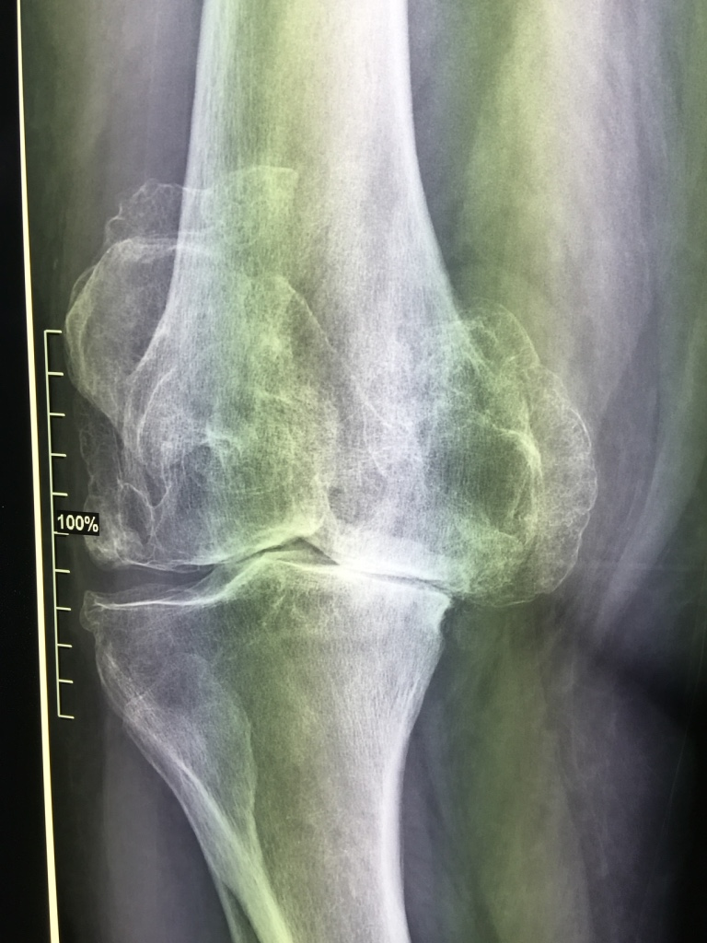
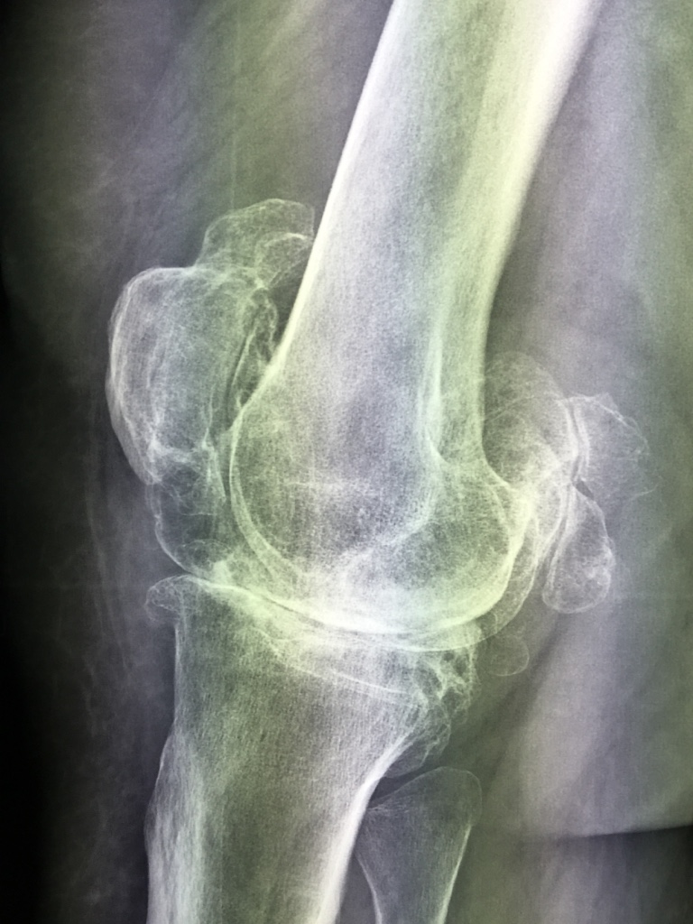
DONNA 63aa

Slide 50
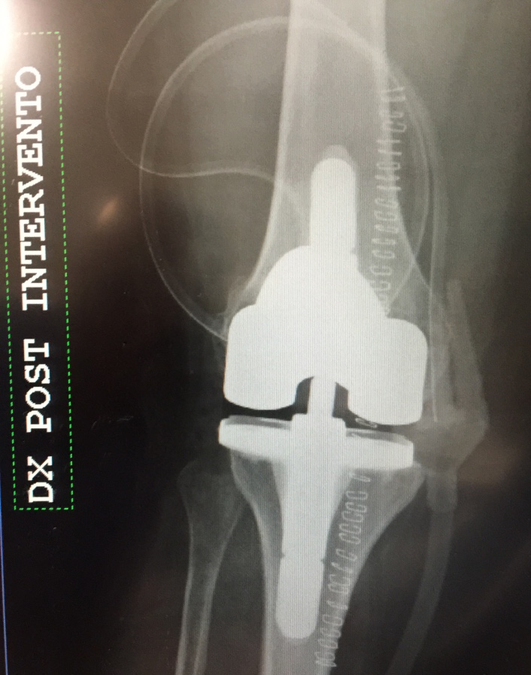
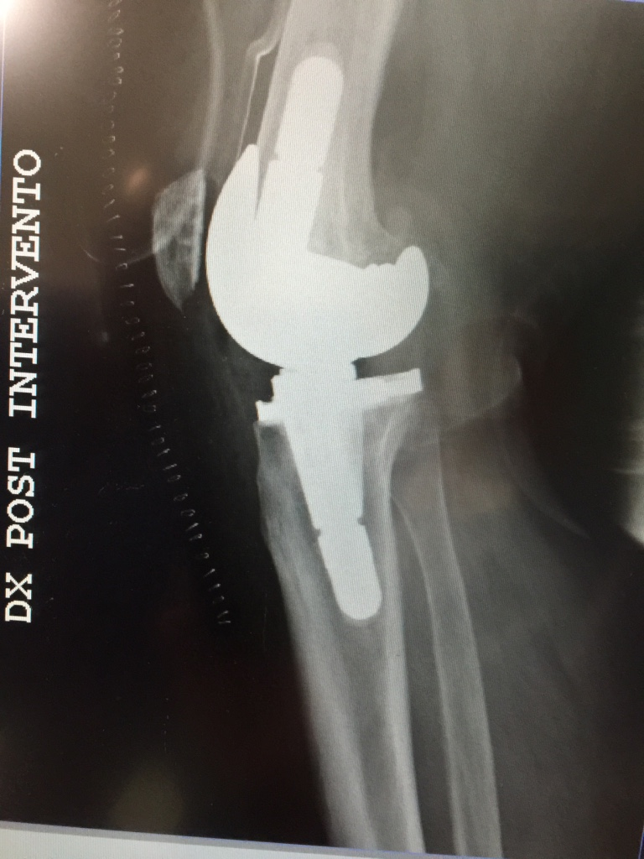
DONNA 63aa

Slide 51
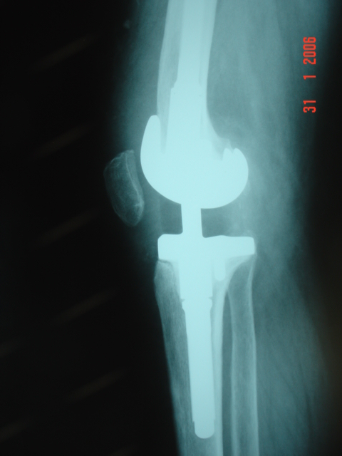
QUANDO VINCOLATA
QUALITA’ OSSEA GRAVEMENTE SCADENTE
PIVOT CENTRALE INSTABILE: LCP
ARTI NEUROLOGICI
COLLATERALI INSUFFICIENTI

Slide 52
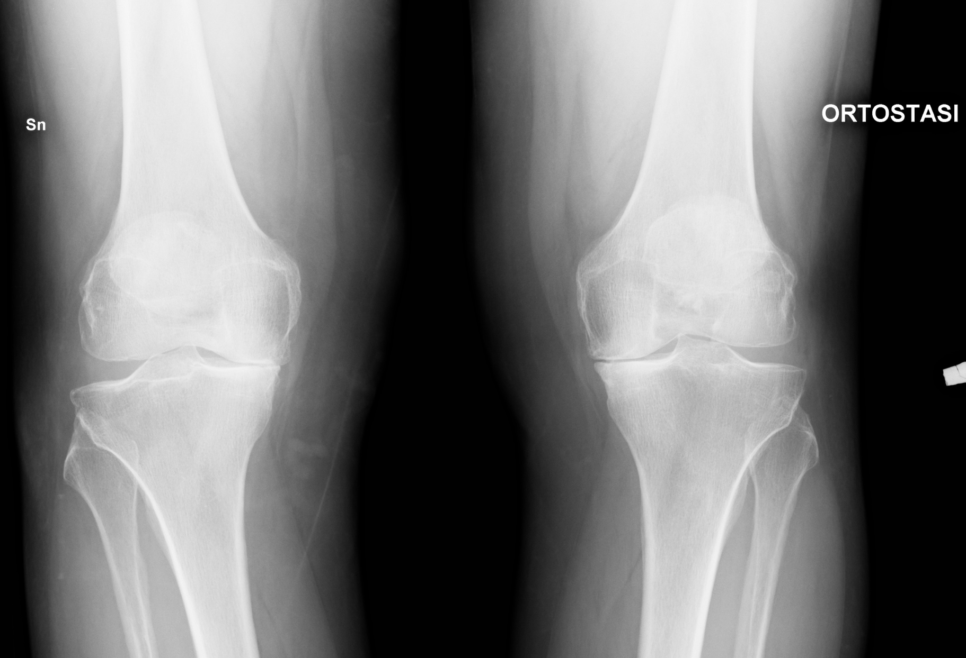
MA QUANDO POSSIBILE:

Slide 53
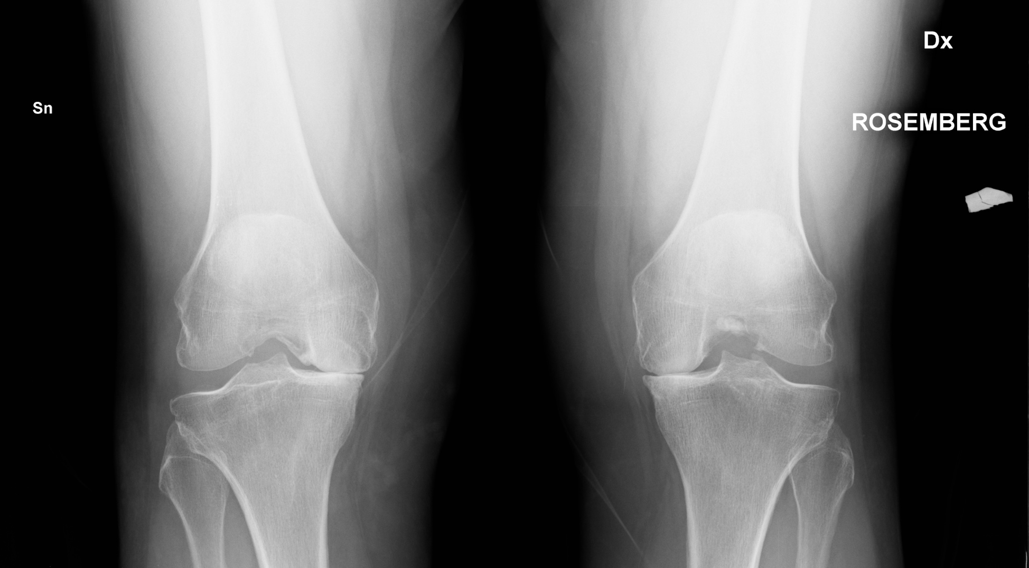
MA QUANDO POSSIBILE:

Slide 54
MA QUANDO POSSIBILE: MONOCOMPARTIMENTALI

Slide 55
MA QUANDO POSSIBILE: MONOCOMPARTIMENTALI

Slide 56
MA QUANDO POSSIBILE: MONOCOMPARTIMENTALI

Slide 57
“Behind every tecnique
and every design
there are
choices and compromises”
John Insall

Slide 58
GRAZIE alessandro@tripodo.net

